Slide 1
MINI PROJECT-II
FINAL PRESENTATION
GROUP MEMBERS:
MOULINDU MANDAL (ENROL- 510619110)
DIPTARKA ROY (ENROL- 510619111)
AISHWARYA RAJ (ENROL-510619114)

Slide 2
SMART WATER LEVEL INDICATOR
WITH AUTOMATIC PUMP SWITCHING ACTION
A PROJECT TO REDUCE HOUSEHOLD WATER WASTAGE FROM OVERHEAD TANKS

Slide 3

OBJECTIVES
To build a smart water level indicator.
To integrate said WLI with the internet.
Hence to minimize water wastage from overhead tanks.

Slide 4
PROJECT WORKFLOW
PART-I
PART-II
PART-III
PART-IV
DEVELOPMENT OF A SIMPLE WATER LEVEL INDICATOR: Understanding the basics of how a water level indicator actually worked.
SELECTION OF COMPONENTS AND INTEGRATING WITH MICROCONTROLLER: This part included the selection of microcontroller and other components.
CODING: Writing and understanding the code in the Arduino IDE. Also development of web page to display water level data
DEVELOPMENT OF WORKING MODEL: Development of final working model as per our project research.

Slide 5
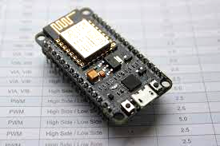
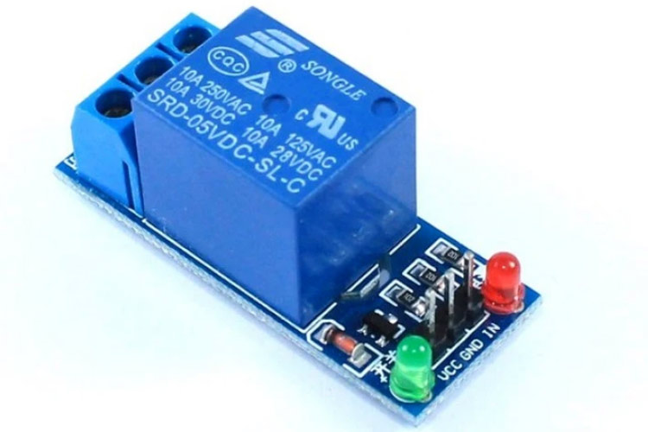
COMPONENTS-I
NODEMCU
NodeMCU is a development board specifically targeted for IOT-based project. It has the Xtensa microprocessor integrated into it. This was chosen over the commonly used Arduino as an Arduino cannot directly interface with the internet.
RELAY MODULE
A relay module involving a DC relay is being used to switch the motor ON and OFF as per the controller commands.

Slide 6
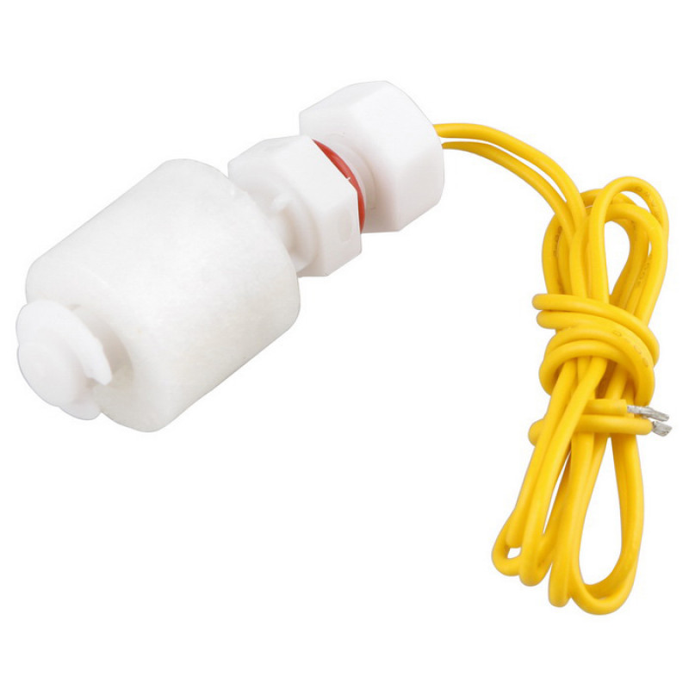
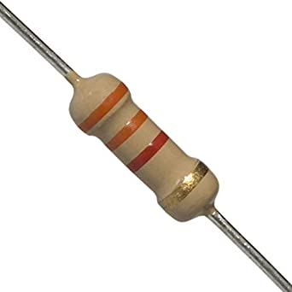
COMPONENTS-II
FLOAT SENSOR (REED-TYPE NO SWITCH)
The float sensor here is nothing but a reed-type magnetic switch. It cannot sense water level data at intermediate levels but can only do binary sensing,i.e, it can only detect when the water level is above or below said sensor.
RESISTORS
Resistors are indispensable in the circuit as they prevent the sensitive microcontroller parts from excessive flow of current.

Slide 7
HOW IT WORKS- I
From our new found Control Systems knowledge the entire system is a simple closed loop feed back system as detailed below:
MOTOR ON/OFF
NodeMCU
Relay Module
Water Level in Tank
Controller
Actuator
Float Sensor
Feedback Path

Slide 8
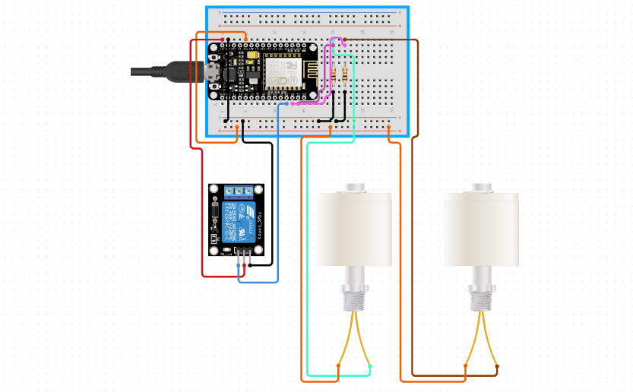
CONNECTION DIAGRAM
Output from relay goes to the motor.
In our model a BC547 transistor was used in CE mode at the input terminals of the relay.
The input power is given through a microUSB cable of +5V.
The float switches can be connected to any of the D1-D6 pins.

Slide 9
TRANSLATING INTO CODE
Various coding languages were used. The Arduino code in the Arduino IDE was used to program the microcontroller while HTML language was used on the web page to log the switching of the motor.
In the setup() part of the loop we connect to the Wifi router using appropriate commands.
In the loop() part of the code we ask the controller to run the code inside it over and over again. The NodeMCU can output upto 3.3V which is enough to drive the relay. If the water level is too high, the motor is turned OFF while if the water level goes below the second float sensor the water level is too low and the Motor is turned ON.
The details of the code has been uploaded to a GitHub repository and has been explained in the report.

Slide 10
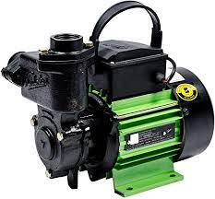
BENEFITS
The following are the benefits of our model of the Water Level Indicator:
It can send water level data through the internet, meaning the data can be accessed from anywhere in the world.
Its cheap and simple to use.
Float sensors can easily handle plenty of iterations of switching, so maintenance is less of an issue.
Conductivity of tank water doesn’t affect water level sensing.

Slide 11
A WORD OF THANKS
A huge amount of thanks to Prof. ABHIJIT CHAKRABARTI. He has been instrumental in helping us craft this project and has been prompt and just in feedback wherever and whenever necessary.
A special vote of thanks to Prof. Prasid Syam, our H.O.D. for his incessant support throughout the project.
Last but not the least, a word of thanks to our friends and seniors who have guided us in our efforts.

Slide 12
REFERENCES
Image Credits:
Amazon.in; robu.in;
References:
How to setup NodeMCU for IoT; 21.05.2021; [Online]; Available: https://www.instructables.com/How-to-Setup-Node-MCU-for-IOT-ESP8266-Board/
Water Level Sensors; 21.05.2021; [Online]; Available: https://www.rshydro.co.uk/water-level-sensors/
Esp8266 Technical Reference; 21.05.2021; [Online]; Available: https://www.espressif.com/sites/default/files/documentation/esp8266-technical_reference_en.pdf

Slide 13

THANK YOU
510619110.moulindu@students.iiests.ac.in
510619111.diptarka@students.iiests.ac.in
510619114.aishwarya@students.iiests.ac.in

